Slide 1


Joint Probability Distributions (Continuous)

Slide 2
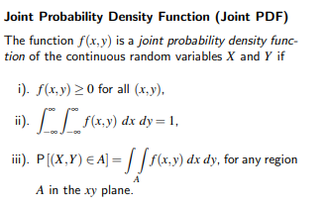

Slide 3
Suppose X and Y both take values in [0,1] with density f(x, y) = 4xy.
Show f(x, y) is a valid joint pdf,
visualize the event A = ‘X < 0.5 and Y > 0.5’ and find its probability.

Slide 4
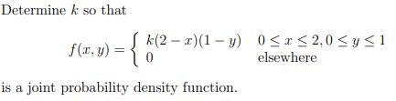

Slide 5


Let X and Y have joint density

Slide 6

Suppose that the random variables X and Y have a joint density function given by
Find
(a) the constant c,
(b) P(X + Y > 4)
Notes:
1/210
33/35

Slide 7
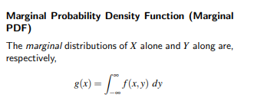


Slide 8


Slide 10

Consider the joint density function of the random variables X and Y:
Find marginal pdfs
Find P(X>1/2)
Notes:
½(1-ln2)

Slide 11
Consider the joint density function of the random variables X and Y:
Find 𝑅_{𝑋𝑌} and show it in the x−y plane.
Find the constant 𝑐.
Find marginal PDFs, 𝑓_{𝑋}(𝑥) and 𝑓_{𝑌}(𝑦).
Find P(Y≤X/2).
Find P(Y≤X/4|Y≤X/2)
$$f_{XY}\left(x,y\right)=\left\{\begin{matrix}cx^{2}y, 0≤y≤x≤1 \\ 0, otherwise\end{matrix}\right.$$

Slide 13
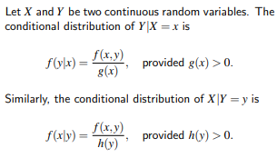
Conditional Probability Density Function (Conditional PDF)

Slide 14
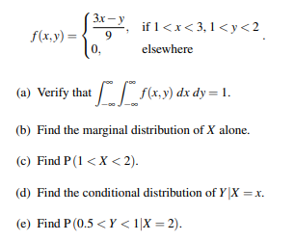
Consider the joint probability density function of the random variables X and Y:

Slide 15
Notes:
2.P(X ≤ 1,Y = 1) = 5/27
3. P(Y=1) = 1/3
4. P(X ≤ 1|Y = 1) = 5/9

Slide 16
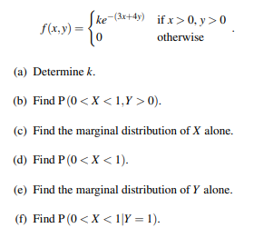
Consider the joint density function of the random variables X and Y:

Slide 17
Notes:
2.P(X ≤ 1,Y = 1) = 5/27
3. P(Y=1) = 1/3
4. P(X ≤ 1|Y = 1) = 5/9

Slide 18
Notes:
2.P(X ≤ 1,Y = 1) = 5/27
3. P(Y=1) = 1/3
4. P(X ≤ 1|Y = 1) = 5/9

Slide 19
Multivariate Distributions
We frequently need to examine two or more (discrete or continuous) random variables simultaneously.

Slide 20
For three or more variables
Let X₁,X₂,...,X_{n} be n random variables, discrete or continuous, with joint probability distribution f(x₁, x₂,..., x_{n}) and marginal distribution f₁(x₁), f₂(x₂),..., f_{n}(x_{n}), respectively.
The random variables X₁,X₂,...,X_{n} are said to be mutually statistically independent if and only if f(x₁, x₂,..., x_{n}) = f₁(x₁)f₂(x₂)··· f_{n}(x_{n}) for all (x₁, x₂,..., x_{n}) within their range.

Slide 21
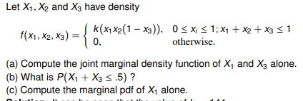
Notes:
72x1(1 − x3)(1 − x1 − x3)²
0.53125
18x1 − 48x1² + 36x1³ − 6x1⁵ , 0 ≤ x1 ≤ 1

Slide 23

Cumulative distribution function
Let X, Y be random variables (discrete or continuous). Their joint (cumulative) distribution function is
F_{X,Y} (x, y) = P(X ≤ x, Y ≤ y)
If we know the joint cdf, then we can compute the joint pdf by taking partial derivatives of the above :

Slide 24
Expectation and Variance in Joint random variables

Slide 25
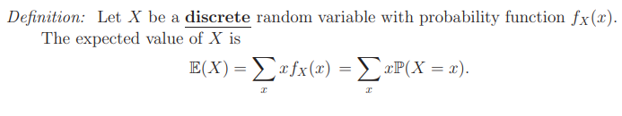
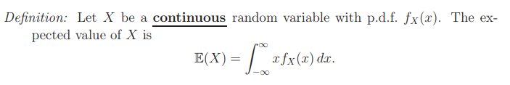
Expectation
The mean, expected value, or expectation of a random variable X is written as E(X) or µ_{X}

Slide 26

Variance
The variance of a random variable X is a measure of how spread out it is.

Slide 27
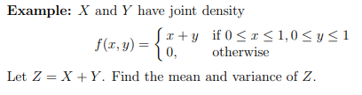

Slide 28
Covariance
Covariance is a measure of the association or dependence between two random variables X and Y . Covariance can be either positive or negative.
(Variance is always positive.)
Let X and Y be any random variables.
The covariance between X and Y is given by
cov(X, Y ) = E { (X − µ_{X})(Y − µ_{Y} ) } = E(XY ) − E(X)E(Y ),
where µX = E(X), µY = E(Y )

Slide 29
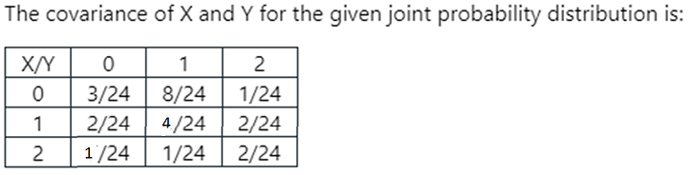

Slide 30
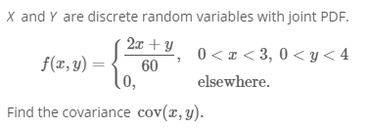

Slide 31

Thank you

